Slide 1
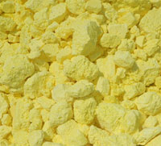
Let’s see how chemists describe what happens when pure sulfur burns
Solid sulfur
Oxygen gas
Sulfur dioxide gas
Law of conservation of matter …
Chemical Equation …

Slide 2
Let’s see how chemists describe what happens when pure sulfur burns
Solid sulfur
Oxygen gas
Sulfur dioxide gas
Law of conservation of matter …
1 sulfur atom on left, 1 on right
2 oxygen atoms on left, 2 on right
Chemical Equation …
S + O₂ → SO₂
Or!
2 S + O₂ → 2 SO

Slide 3
Let’s see how chemists describe what happens when pure sulfur burns
Solid sulfur
Oxygen gas
Sulfur dioxide gas
Law of conservation of matter …
1 sulfur atom on left, 1 on right
2 oxygen atoms on left, 2 on right
Chemical Equation …
S + O₂ → SO₂
Chemical Equation w/state indicated …
S(s) + O₂(g) → SO₂(g)

